Slide 1
Migration crisis
Irish Red Cross Response
Register of Pledges
Accommodation Verification
April 2016

Slide 2
Common Terms and phrases
Asylum Seeker
Relocation
Migration Crisis
v Refugee Crisis
Refugee
Resettlement
Reception/ Accommodation Centre
Migrant

Slide 3
Overview of Presentation
Red Cross Red Crescent Activities along the Migration Trail
Ireland’s Response, including Irish Red Cross involvement
Register of Pledges (verifications)
Next Steps

Slide 4
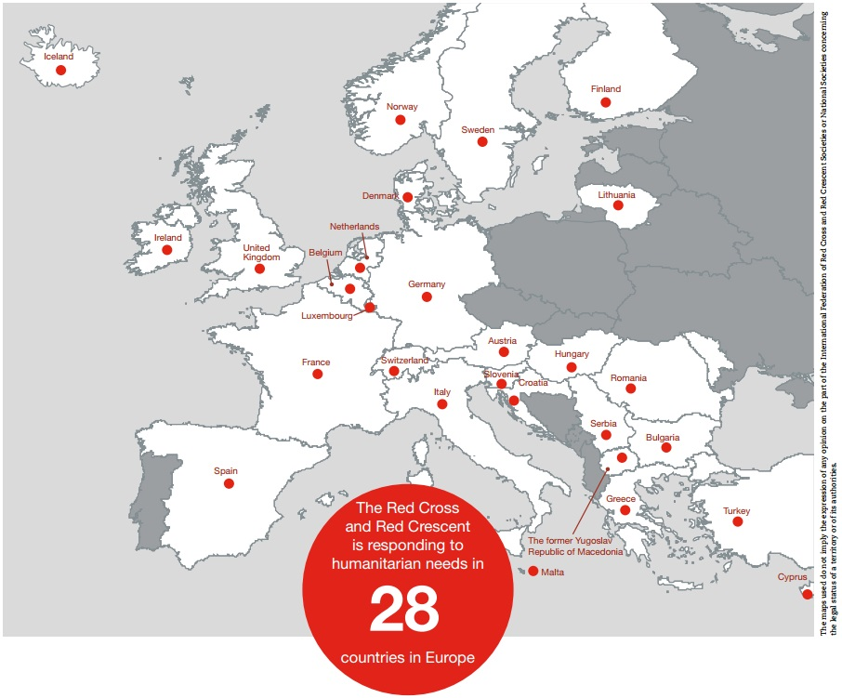
Notes:
Map valid 2/2/16

Slide 5
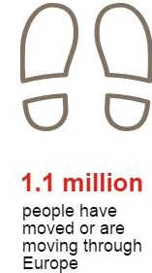
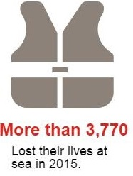
Migration Overview
are the main points of entry.
The main countries of origin are Syria, Afghanistan, Iraq and Eritrea
Notes:
Since the beginning of 2015, more than 1 million people have moved or are moving through Europe (50% women and children) Recent figures also estimated that a further 34,000 have crossed from Turkey into Bulgaria and Greece by land.
During first 6 weeks of 2016, more than 80,000 migrants arrived in Europe by sea, more than in the first four months of 2015 (UNHCR); more than 400 people had lost their lives trying to cross the Mediterranean.
Primary entry points are Greece and Italy, with lower numbers arriving in Cyprus, Malta and Spain. Average daily arrivals in Greece is 1,800 people per day, monthly this year (UNHCR, January 2016). More than 3,770 people have died or gone missing at sea (IOM, end of year 2015). The most common countries of origin are Syria (48%), Afghanistan (21%), Iraq (9%) and Eritrea (UNHCR data, 2016). The vast majority of people arrive by boat from Turkey to islands in Greece. From there, they travel by train, bus and foot north through FYR Macedonia, Serbia, Croatia, Slovenia and Austria to reach Germany. While Germany is the primary country of destination, some stay in Austria or continue onwards to Belgium, Denmark, Sweden, Norway, and Finland.
UNHCR

Slide 6
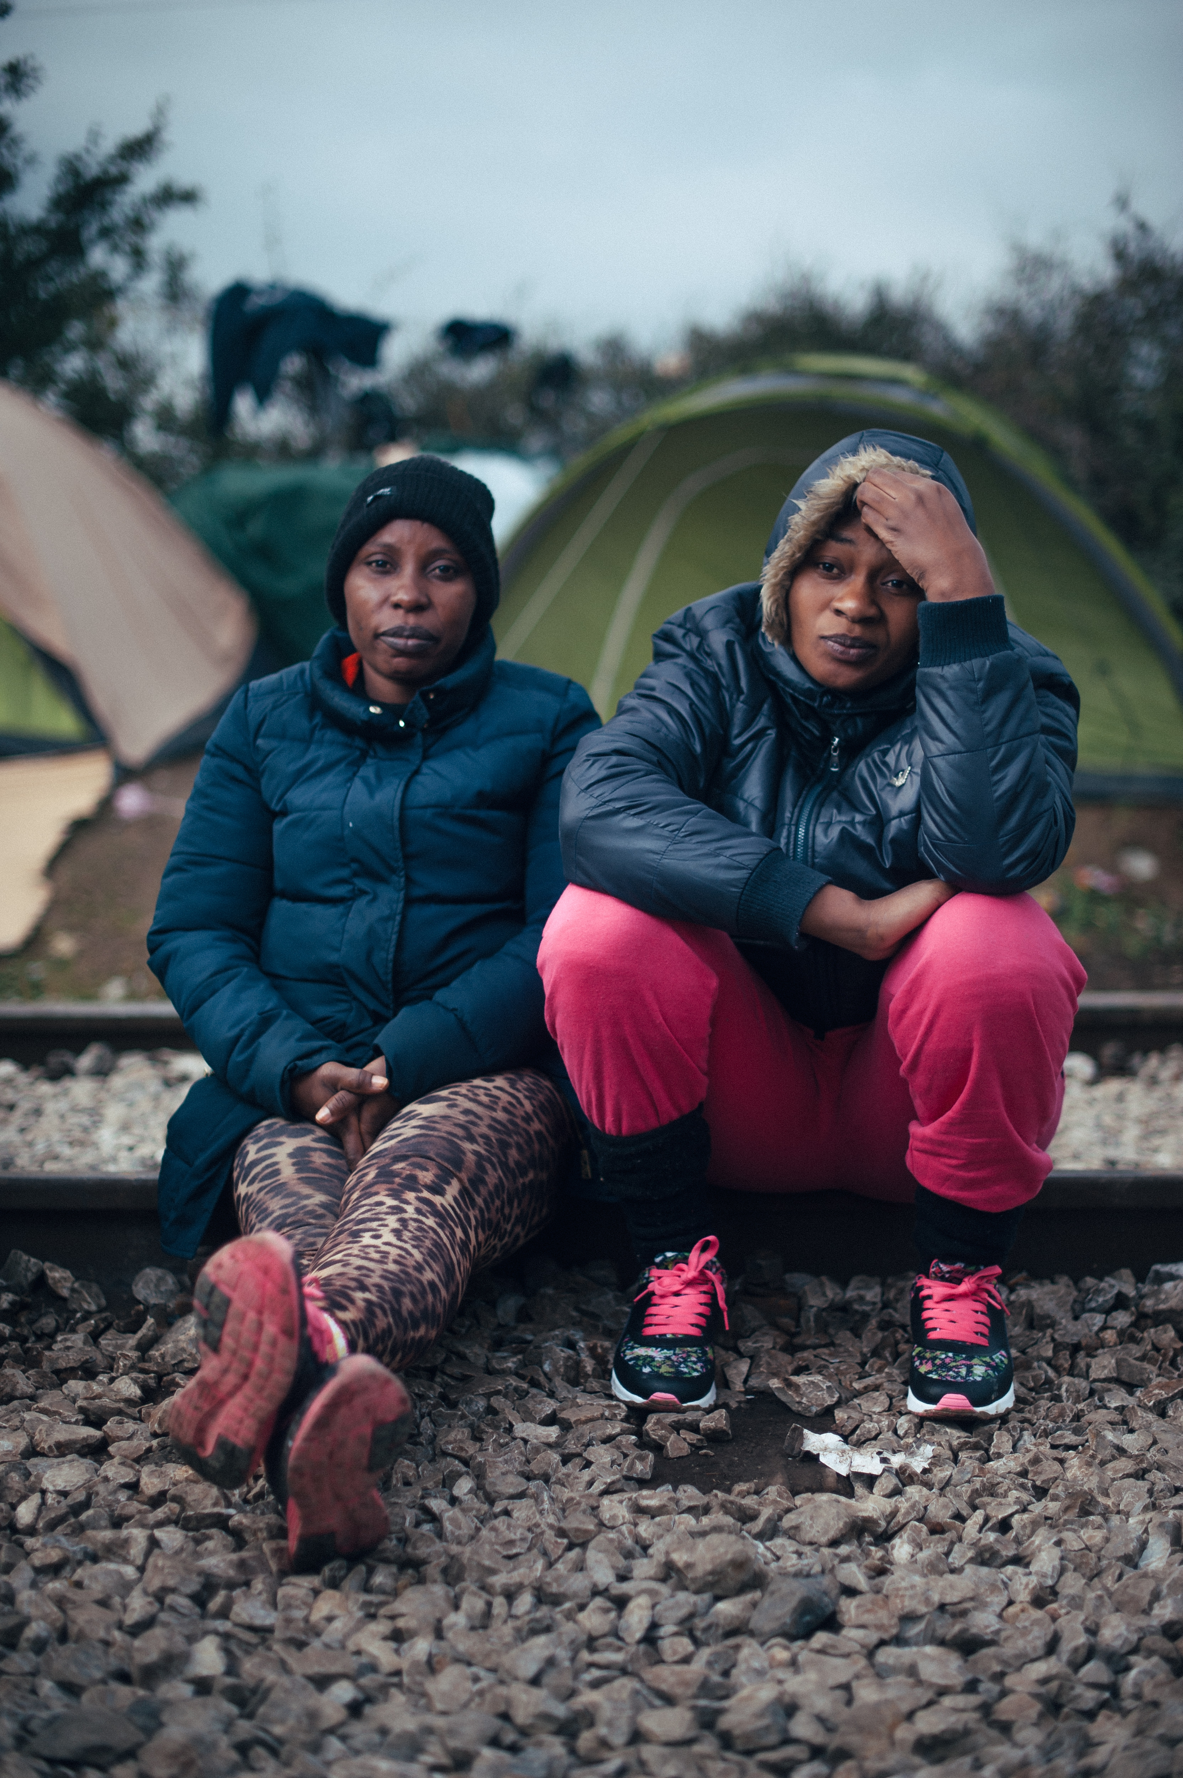
Migration Overview
Many stay no more than 12-48 hours
While Germany primarily remains the preferred destination, some stay in Austria or continue onwards to Belgium, Denmark, Sweden, Norway, and Finland
2016
The amount of migrants that have arrived in January is more than the combined total for first five months of 2015.
406 casualties (died/missing at sea) have been verified during that first weeks alone
Number of arrivals to Greece continues to remain large and reached an average of 1,900 people daily, despite winter weather
Source UNHCR
Notes:
Vulnerable people on the move are in need of shelter, food and water, as well as first aid and medical care. The onset of winter is a great humanitarian concern. According to UNHCR the amount of migrants that have arrived in October alone nearly equal the total of all of 2014. Almost 400 casualties have been verified during that month alone. Lately, the number of arrivals to Greece is growing and has reached an average of 8,000 people daily.
The primary migratory route from Greece continues to be through the Former Yugoslav Republic of Macedonia, Serbia, Croatia and Slovenia since Hungary closed its border with Croatia. Lately, the national authorities along the route (e.g. Serbia, Croatia and Slovenia) have limited the number of people crossing their borders increasing the amount of people waiting for more than 12-24 hours in various countries. This increases their vulnerabilities as many migrants’ lack adequate clothing and shelters are not properly heated for the colder weather, and leads to frustration among those who wait. Austria has also stated that it may build a fence on its border with Slovenia.
The closing (temporary in cases, see FYRM) of borders has had substantial impacts on the movement of migrants, as well as their safety. As of 22/2/16, UNHCR notes that Serbian borders remain open to Iraqi, Afghan and Syrian nationals only in line with an agreement made between Heads of Police from the former Yugoslav Republic of Macedonia, Serbia, Croatia, Slovenia and Austria. Entry is forbidden for Moroccans, Algerians, Libyans and numerous
other nations from countries deemed as not war affected. While the Austrian daily limit of 80 asylum applications/transit of 3,200 per day has been introduced, the Austrian Minister of Interior already announced the further lowering of this limit in the future (UNHCR).

Slide 7
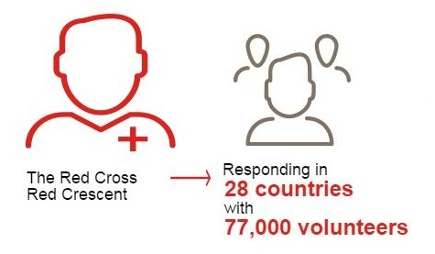
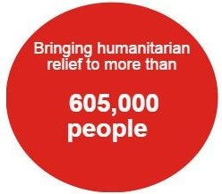
The Response
Notes:
Since the beginning of 2015, more than 1 million people have moved or are moving through Europe (50% women and children) Recent figures also estimated that a further 34,000 have crossed from Turkey into Bulgaria and Greece by land.
During first 6 weeks of 2016, more than 80,000 migrants arrived in Europe by sea, more than in the first four months of 2015 (UNHCR); more than 400 people had lost their lives trying to cross the Mediterranean.
Primary entry points are Greece and Italy, with lower numbers arriving in Cyprus, Malta and Spain. Average daily arrivals in Greece is 1,800 people per day, monthly this year (UNHCR, January 2016). More than 3,770 people have died or gone missing at sea (IOM, end of year 2015). The most common countries of origin are Syria (48%), Afghanistan (21%), Iraq (9%) and Eritrea (UNHCR data, 2016). The vast majority of people arrive by boat from Turkey to islands in Greece. From there, they travel by train, bus and foot north through FYR Macedonia, Serbia, Croatia, Slovenia and Austria to reach Germany. While Germany is the primary country of destination, some stay in Austria or continue onwards to Belgium, Denmark, Sweden, Norway, and Finland.
UNHCR

Slide 8
Commitment to 4,000 persons overall (relocation and resettlement)
Approx, 2, 600 persons seeking asylum (from Greece and Italy) in 2016-17
Approx. 520 resettled persons from Lebanon
Remainder to be determined according to need
Ireland’s Response
Funding of €25 million allocated
Irish Refugee Protection Programme (IRPP) established in late Summer 2015
New programme office to oversee the relocation of asylum seekers, Dept. Justice and Equality
Notes:
John Roycroft, a PO within the Department, has been appointed as Programme Director and the office is in the process of gradually scaling up its human and financial resources.
EROCs will facilitate the initial acceptance and processing of those in need of international protection. The deadline for receipt of expressions was Friday 28 October. The expressions of interest are currently being evaluated alongside the information provided by OPW in respect of State properties
It is possible that a small number may be relocated in December. The programme will concentrate on families to the greatest possible extent. A further 520 programme refugees (from Lebanon, Syrian nationals) will also be resettled in the period 2015-2016. A balance of 858 persons from the Government Decision are yet to be allocated.
Programme- An increase of 89% (total budget €4.445 million) has also been made available in funding for the Office for the Promotion of Migrant Integration to allow for additional staffing and integration measures to support the increased intake of programme refugees in 2016

Slide 9
Ireland’s Response
First task of new Department office was to establish Emergency Reception and Orientation Centres (EROCs)
Accelerated asylum application processing (new International Protection Act 2015)
A cross-departmental Taskforce has been instituted, with 4 sub-groups
Accommodation/housing
Pledges of public support and NGO Liaison
Relocation, refugee applications, EROCs
Other services e.g. health, education, welfare etc.
Notes:
International Protection Act 2015 – introduces a single procedure for international protection applications, as with the rest of Europe (more efficient processing)
Main focus of the Taskforce is for Government departments to provide updates on their work to support refugees joining our communities

Slide 10
Ireland’s response
A family unit of 10 have arrived in Ireland, it is likely that people will arrive in Ireland over the next few months. They will not be joining our communities for some months.
Irish officials have been sent as advanced parties to carry out pre-screening of asylum applicants
Refugee status to be determined within 8-12 weeks in most cases, with their claim heard in Ireland
Notes:
EU relocations are slow so far: 497 so far = 279 from Italy and 218 from Greece as of 10/2/16 (out of 160,000 committed to by EU governments).
A small amount of people arrived in Ireland in January 2016. They will not be joining our communities for some months (you will recall that when migrants arrive they are brought to Emergency Reception & Orientation Centres for support and asylum processing). It is not anticipated that larger groups will begin arriving until over the next few months. Whether this timeline has an implication for our work has yet to be determined.
Irish officials have been sent as advanced parties to carry out pre-screening of asylum applicants as a means of speeding up processing. Minister for Justice Frances Fitzgerald said she hopes the new process, for which legislation is needed, will be much faster than the existing application system, with status confirmed within 8-12 weeks in most cases.

Slide 11
Role of Irish Red Cross
Appointed by Government to the Irish Refugee Protection Programme Taskforce
Role is two-fold:
coordinate pledges of public solidarity and provide the Government with analysis
at a later stage, support the integration of refugees as they join our communities
Cooperation and discussion with civil society and Government about the wider aspect of our role on the IRPP
Notes:
It is nearly six months since the Irish Red Cross was appointed by Government to the Irish Refugee Protection Programme Taskforce. Along with the UNHCR, we are the only non-Government organisation on the Taskforce in recognition of our work as an auxiliary service. We were asked to coordinate pledges of public solidarity and provide the Government with analysis; and at a later stage, support the integration of refugees as they join our communities.
There have been 3 meetings of the Government-appointed Irish Refugee Protection Programme Taskforce to date.
The main focus of the Taskforce was for Government departments to provide updates on their work to support refugees joining our communities next year. It was confirmed that up to 2,500 migrants coming to Ireland will be selected from Greece and Italy. A decision on a further 1,000 will be made as the situation evolves.

Slide 12
Role of Irish Red Cross
Basic needs are met with hygiene/welcome kits provided
access to basic commodities, food and hygiene materials and winter clothes
Restoring Family Links (RFL) service is in place which restores and maintains contact between families separated by conflict, political upheaval, disaster or migration.
Notes:
A small amount of people (10) arrived at the end of January but they they will not be joining our communities for some months (you will recall that when migrants arrive they are brought to Emergency Reception & Orientation Centres for support and asylum processing). It is not anticipated that larger groups will begin to arrive until over the next few months. Whether this timeline has an implication for our work has yet to be determined.
It was also confirmed that Irish officials will be sent as advanced parties to carry out pre-screening of asylum applicants as a means of speeding up processing. Minister for Justice Frances Fitzgerald said she hopes the new process, for which legislation is needed, will be much faster than the existing application system, with status confirmed within 8-12 weeks in most cases.

Slide 13
Notes:
Our Register of Pledges is also being promoted and you may have seen advertising in national newspapers or promoted posts on Facebook and Twitter. Pledges got off to a quick start but have started to slow down. This was expected and we anticipate that high-profile events such as the first arrival of people seeking refuge under the IRPP in Ireland will stimulate public interest.
Cork pilot: 78 pledges verified over 6 week timeframe. Good cooperation. Issues raised include payment/insurance/taxes/dispute resolution/general questions around health, food, cultural needs.)
Next steps to include roll out nationally for remaining 500 accommodation pledges. We will follow the same process as in Cork. Firstly, those who made a pledge will be contacted by email and telephoned to ensure their willingness to meet Red Cross volunteers. Secondly, provided consent is given, volunteers from each area will make contact to establish time and date to meet.

Slide 14
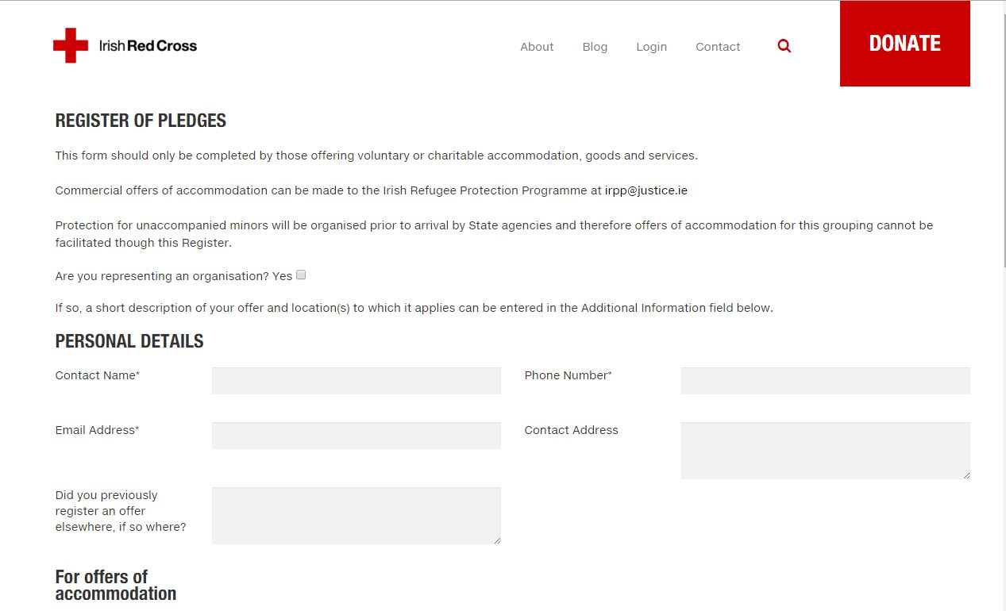
REGISTER OF pledges

Slide 15
Register of pledges
TOTAL PLEDGES | 782 received | Accommodation and Services
ACCOMMODATION | 536 received | 357 confirmed 53 Withdrawn 126 on hold = 483 LIVE pledges
SERVICES | 246 received | Education- 62 Health- 30 Social Support- 37 Other - 117

Slide 16
Register of pledges

Slide 17
Register of pledges

Slide 18
Register of pledges
Notes:
The most significant numbers of accommodation pledges by county are coming from the following areas: The greater Dublin area (particularly in Drumcondra, Dun Laoghaire, Terenure and Raheny) and County Cork (Cork City, Skibbereen, Ballydehob, Bantry, Carrigaline)
Outside of these areas, the counties with the largest numbers of pledges recorded are (In order): Co Clare, Co Galway, Co Wexford, Co Mayo, and Co Kildare.
Co Carlow
6
Co Cavan
10
Co Clare
35
Co Cork
78
Co Donegal
20
Co Dublin
118
Co Galway
32
Co Kerry
14
Co Kildare
21
Co Kilkenny
9
Co Laois
1
Co Leitrim
5
Co Limerick
14
Co Louth
7
Co Mayo
25
Co Meath
20
Co Monaghan
3
Co Offaly
8
Co Roscommon
6
Co Sligo
8
Co Tipperary
15
Co Waterford
7
Co Westmeath
8
Co Wexford
32
Co Wicklow
26
Grand Total
528

Slide 19
Pledge verification programme
Record additional details of property not captured by online register
Offer the Pledgers the opportunity to amend their pledge and ask questions
Confirm existence, condition of pledged property
Document impressions gained of the Pledger, accommodation and locality
Raise awareness of Irish Red Cross role in response to the migration crisis
Notes:
Key Messages: The Irish Red Cross is grateful to the Pledger for their pledge
The purpose of the Pledge Verification Programme is to follow-up on pledges made online
It is a face-to-face courtesy call
It allows a Pledger amend their pledge and ask questions

Slide 20
Pledge verification programme
Guidelines:
Good practice for two volunteers to carry out each visit
Observation: when/what/how
Re-confirm pledge
Questions on how pledge will operate
Liability (property tax/insurance)
Dispute resolution/ending pledge offer
More information on health/dietary/lifestyle requirements and/or preferences
Questions on migration situation in Ireland/Europe

Slide 21
Next steps
Pledge Verification Programme: finalise all accommodation verifications, conduct branch reviews and provide feedback (issues/questions/recommendations) ‘end May 2016
Provide detailed analysis and systematic ranking of offers for Government IRPP Taskforce ‘end May 2016
Volunteer Training in working with migrant population/cultural orientation ‘pilot end April 2016, roll out nationally end May 2016

Slide 22
